Slide 1
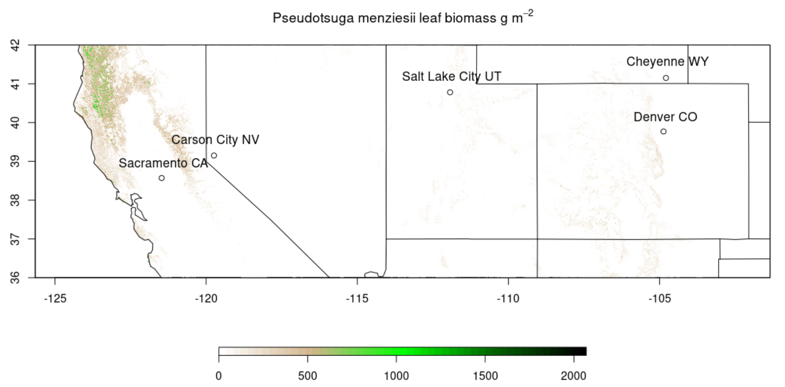
Description and preliminary evaluation of BELD 6 and BEIS 4
Jesse O. Bash and Jeff Vukovich
CEMM, AESMD

Slide 2
Disclaimer: The views expressed in this presentation are those of the authors and do not necessarily reflect the views or policies of the U.S. EPA.
Office of Research and Development
National Exposure Research Laboratory , Computational Exposure Division
Notes:
Disclaimer may be placed elsewhere in the presentation (such as the title slide or the “final” slide); however, it should be clearly legible.

Slide 3
BELD and BEIS updates
BEIS4
Updates are targeted to make the model easier to use and more consistent with the driving meteorology
Seasonality now estimated from the 1-meter soil temperature (removes bioseasons file)
Uses meteorological model values of LAI for isoprene, MBO, and Methanol
BELD6
Uses USFS Research Data Archives forest biomass
Total carbon stock and live tree basal area (RDS-2013-0004 and RDS-2013-0013 respectively)
250 m native resolution and a product of MODIS satellite data and Forest Inventory and Analysis (FIA) data
Renamed tree species based on scientific name, now uses mass-based emission factors, and revised emission factors based on recent observations

Slide 4
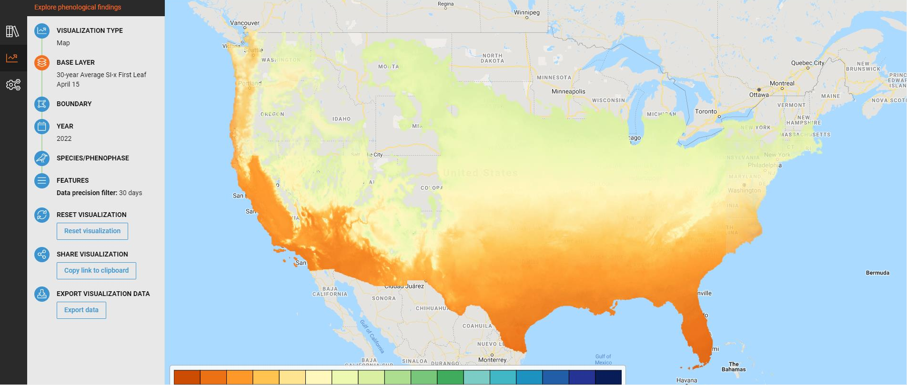
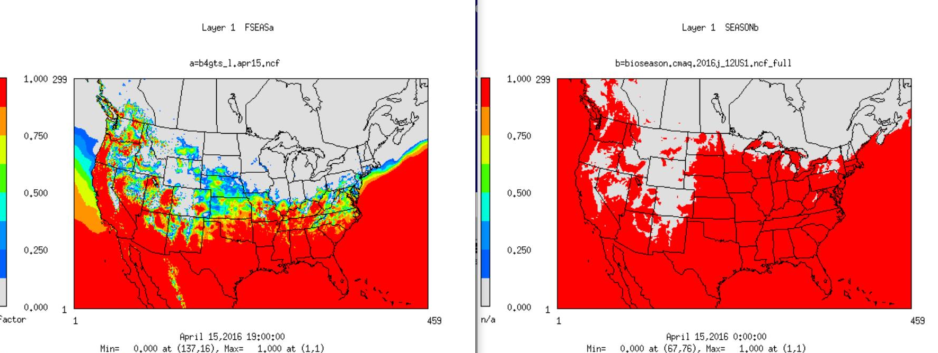
BEIS 4 Seasonality
Seasonality based on deep soil temperature following the WRF PX land surface model
Scales from winter to summer grid cell emission factors based on LAI
Qualitatively evaluated against the USA National Phenology Network (https://usanpn.org )
Matches the patterns of 30 mean values for leaf emergence observations better than the bioseasons file

Slide 5
USFS Live Tree Basal Area
Individual FIA tree species basal area estimates based on survey data and MODIS 250-meter resolution satellite data
Jenkins et al. 2001 allometric scaling used to estimate:
Mean grid cell tree diameter
Species total above ground carbon stock
Species leaf biomass
Total above ground carbon stock
Sum of the tree species carbon stock

Slide 6
USFS Total Above Ground Carbon Stock
Based on Jenkins et al. 2001 allometric scaling of FIA and MODIS 250-meter land use data
Similar to BELD 5 methodology but higher resolution and more accurate input data
Used to normalize the individual tree biomass data
Can differ from the total biomass data as the species count is not known in grid cell

Slide 7
BELD Species Names and Emission Factors
Switched to scientific names for tree species
The number of species was cross referenced by emission factors and total US biomass to determine the number of unique species
Emission factors were taken from the NCAR BVOC Enclosure Database
Logic of emission factor estimation
Median value used if more than one emission factor is present
Median of the genus if species level data are unavailable
Uses BEIS 3 evergreen or broadleaf (PFT) values if no data are available
Switched the units of emission factors to µgC g⁻¹ h⁻¹ from gC km⁻² h⁻¹
Consistent with observed units and allows the incorporation of newly available grid cell specific biomass data
Canadian, Mexico and non-tree species retain the global biomass factors from BELD 5

Slide 8
CMAQ Simulations
2016 annual simulation
12km grid resolution 12US1 (CONUS) domain
2016fh emissions (2016 version 1 platform) used for non-biogenic emissions
EQUATES hemispheric CMAQ boundary conditions (https://www.epa.gov/cmaq/equates)
EQUATES meteorology
WRF 4.1.1/MCIPv5.1, PX LSM, MODIS 20 land use
Base Simulation
CMAQ v5.3.2 with inline BEIS3/BELD5
Sensitivity Simulation
CMAQ v5.3.2 with inline BEIS4/BELD6

Slide 9
CONUS Isoprene AQS Daily
AQS Daily Isoprene
BELD 6 / BEIS 4
BELD 5 / BEIS 3
Reduced model bias and error
Mean biased low
Median biased high
Mean bias driven by outliers
Reduces bias at 70% of sites and error at 65% of sites

Slide 10
CONUS Isoprene AQS Daily
Seasonality is captured well
Underestimates July and August
Driven largely by observations in areas with heterogenous and complex land scape
Clear improvement over BEIS3/BELD5
AQS Daily Isopene
BELD 6 / BEIS 4
BELD 5 / BEIS 3

Slide 11
CONUS Hourly Isoprene
AQS Hourly
BELD 6 / BEIS 4
BELD 5 / BEIS 3
AQS Hourly
BELD 6 / BEIS 4
BELD 5 / BEIS 3

Slide 12
VISTAS Isoprene AQS Daily
AQS Daily Isoprene
BELD 6 / BEIS 4
BELD 5 / BEIS 3
AQS Daily Isoprene
BELD 6 / BEIS 4
BELD 5 / BEIS 3

Slide 13
Colorado Isoprene AQS Daily
AQS Daily Isoprene
BELD 6 / BEIS 4
BELD 5 / BEIS 3
Captures median values well
Reduced bias and error when compared to BELD3/BEIS5
Does not capture some high observed values
Resulting in underestimating the mean observed values
The cause of this underestimation is unclear

Slide 14
Colorado Isoprene AQS Daily
AQS Daily Isoprene
BELD 6 / BEIS 4
BELD 5 / BEIS 3
Seasonality is captured well
Underestimates July and August concentrations
Hourly isoprene observations would be useful
Complex terrain may contribute to the bias
Biased low at higher elevation (observations near Glenwood Springs)
Biased high at lower elevation (Denver/Greeley)

Slide 15
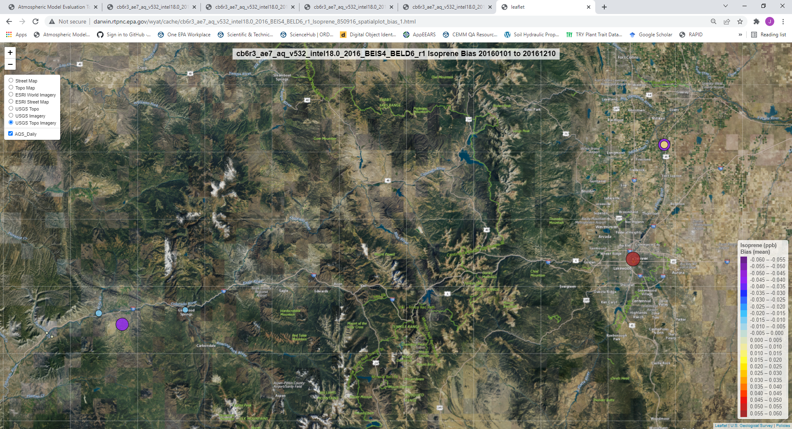
BELD 6/ BEIS 4 Isoprene AQS Daily Bias Map

Slide 16
Colorado O₃ and PM_{2.5} (June-August 2016)
AQS Daily 8 Hour Max O₃
BELD 6 / BEIS 4
BELD 5 / BEIS 3
AQS Daily PM_{2.5}
BELD 6 / BEIS 4
BELD 5 / BEIS 3

Slide 17
Summary
BELD 6 utilizes high resolution USFS tree biomass data and revised emission factors
BEIS 4 has been updated to eliminate the bioseasons file and use meteorological LAI (including satellite LAI)
Evaluates much better against AQS isoprene observations
Particularly in areas with more homogeneous land cover
Slight reduction in 8 hour max O₃ error with a similar absolute bias in CO
Slight increase in PM_{2.5} bias and error in CO
Summertime underestimates are largest in areas with complex terrain and are sensitive to morning/evening emissions
Unclear if this is related to emissions or meteorological dynamics

Slide 18
Next Steps
Publication of these updates and results
Development of a tool to incorporate MEGAN emission factors
Collaborating with future PTR/MS flux measurements
Eddy covariance fluxes with intensive chamber/cuvette measurements
Developing code to test bidirectional BVOC parameterizations
Initially for field scale applications
Collaborating on a complex terrain measurement/modeling workgroup
Lead by the UK’s Center for Ecology and Hydrology

